Slide 1
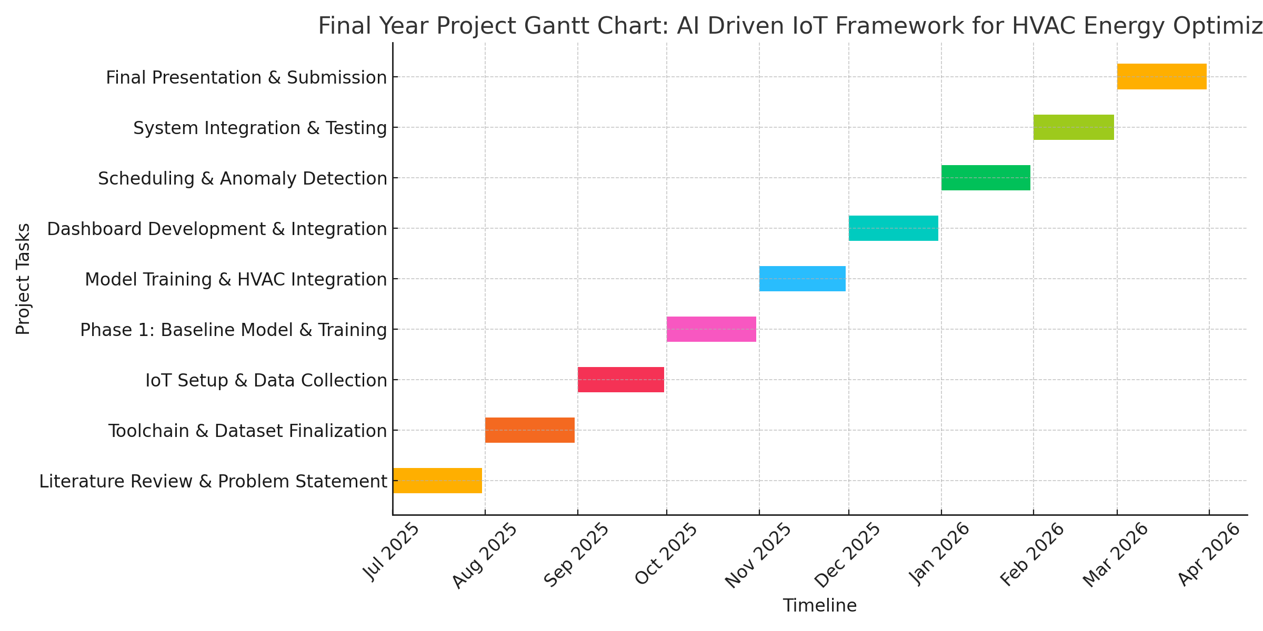
Final Year Project Gantt Chart

